Slide 1
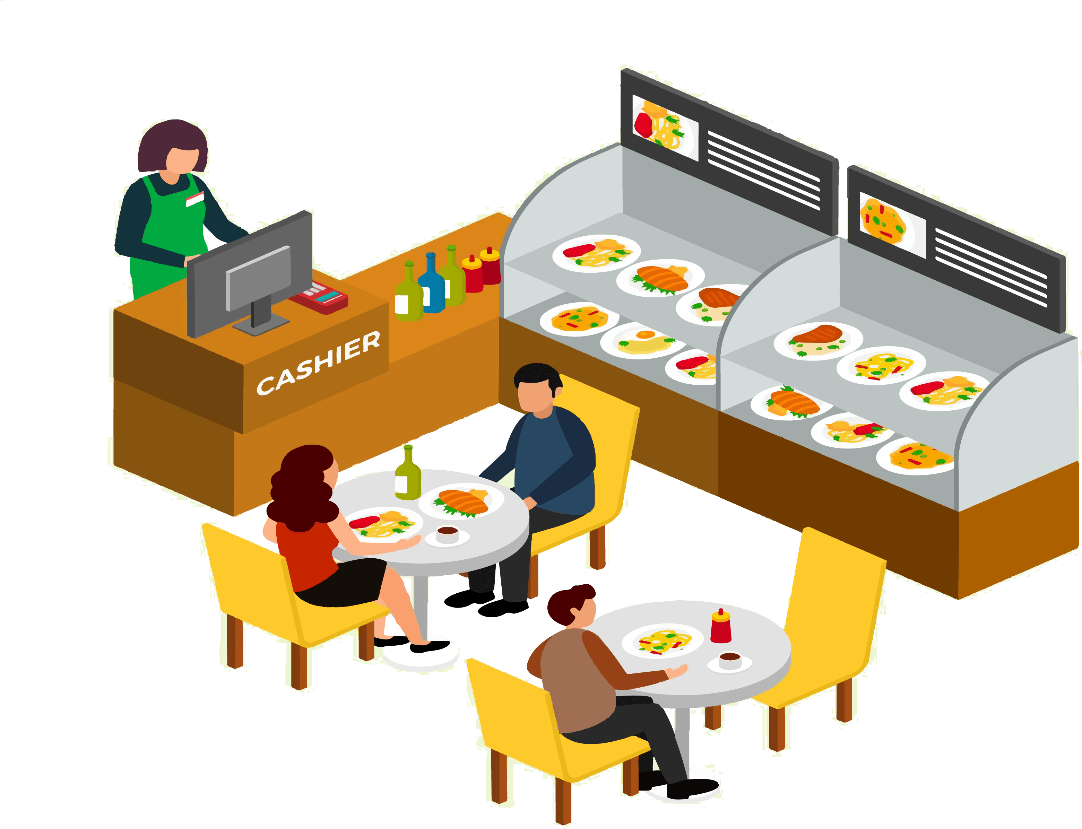
Canteen Food Ordering
System
YOGINI GAMI(212308034)

Slide 2
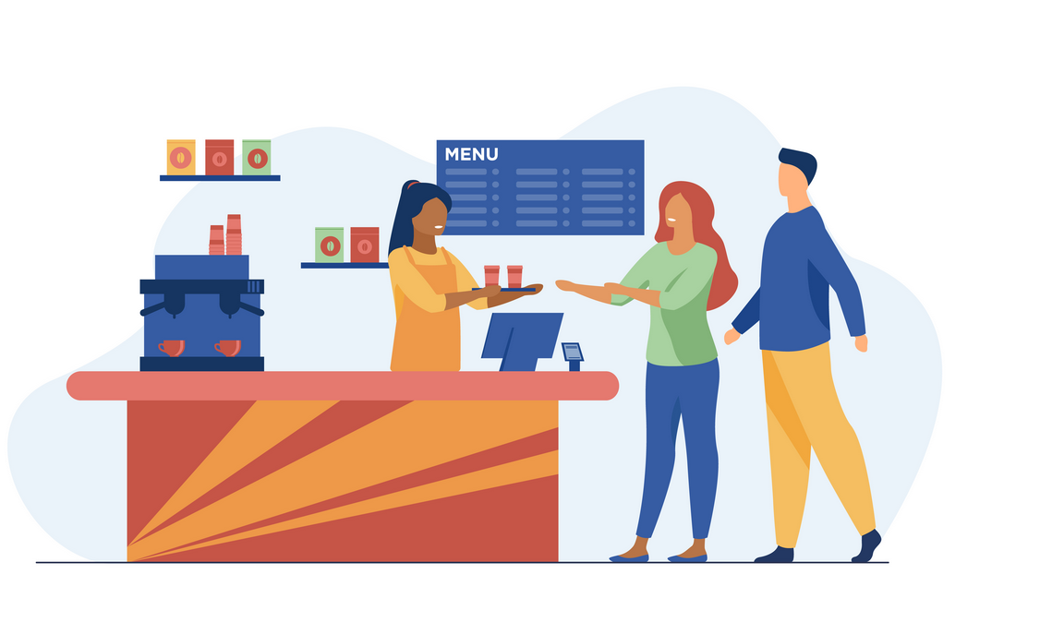
Agenda
Introduction
Existing System
System Flow Chart
Use Case
E-R Diagram
New System
Data Flow Diagram
Activity Diagram
Use-case(Diagram)
Data Dictionary

Slide 3
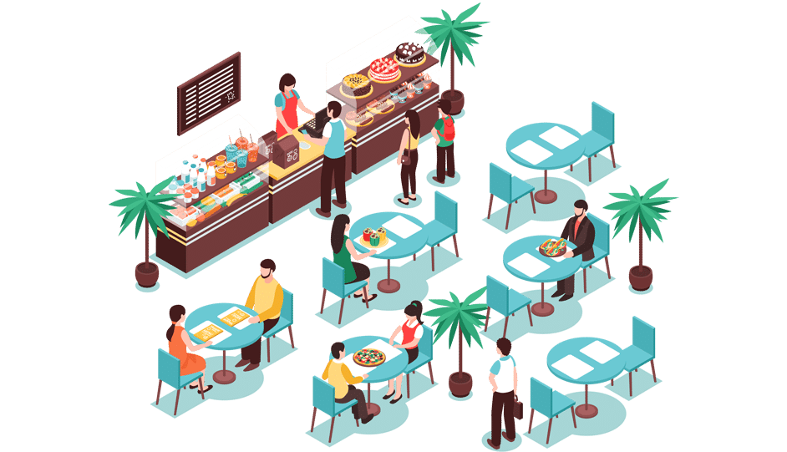
Introduction
Canteen Food Ordering System is to provide fast services to their college students.
Customer can order food online also .

Slide 4
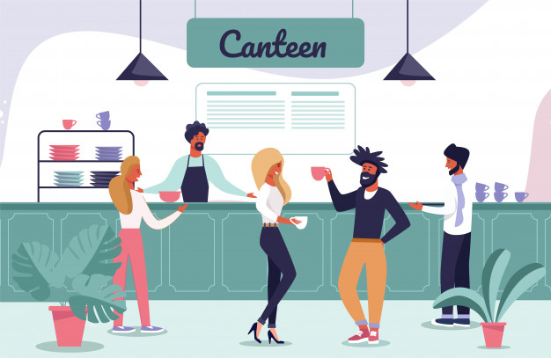
Existing
System

Slide 5
Usually, People have to go canteen and order the foods and they have to wait in queue for a long time to give the orders, a coupon is provided which has be shown at the counter and than wait for sometime than order will be ready.

Slide 6
System
Flow
Chart

Slide 7
CUSTOMER visit canteen
REQUEST FOR ITEM
YES
ITEM AVALABLE?
NO
COUPON
PAYMENT
SALE
END
END

Slide 8
Use Case

Slide 9
CUSTOMER
    Customer request the order the item and when item’s are available then receive the items and pay payment.
ADMIN
    Take order and Generate bill.

Slide 10
E-R Diagram

Slide 11
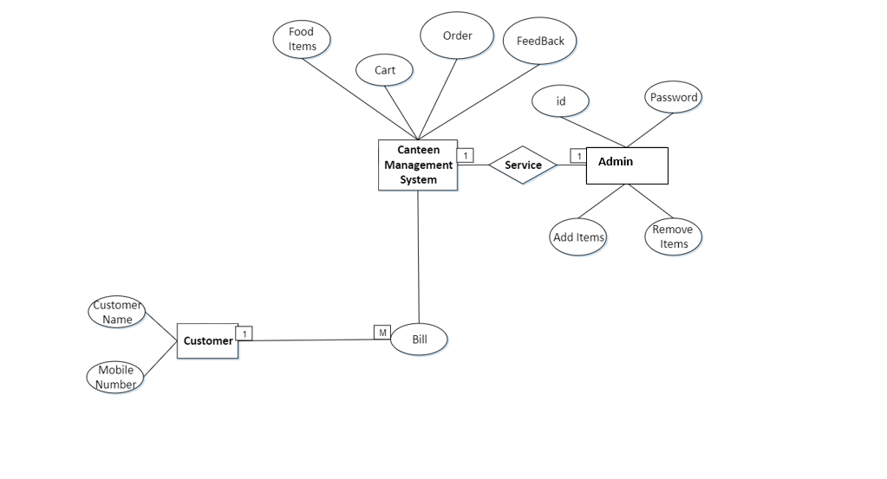
bill

Slide 12
New
System

Slide 13
Canteen Food Ordering System take the order online from the customer and generate the bill.

Slide 14
Data
Flow
Diagram

Slide 15
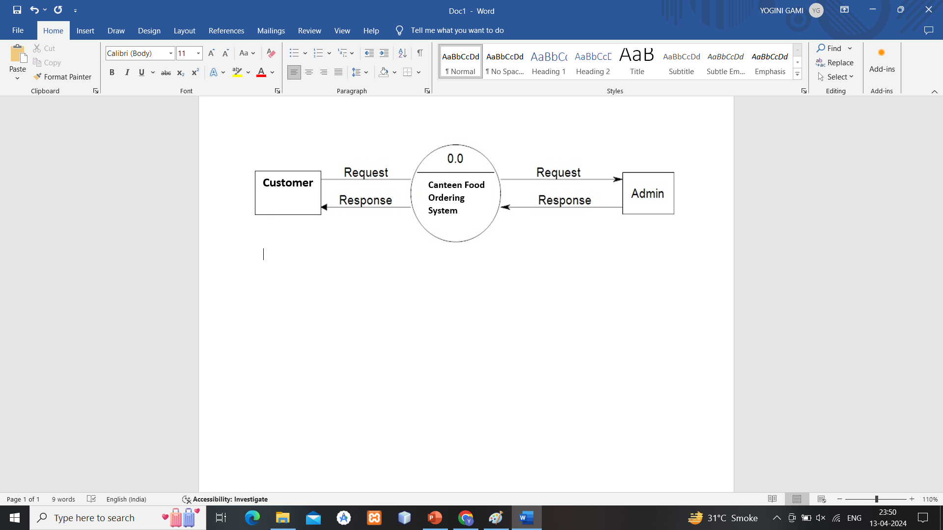
CONTEXT LEVEL

Slide 16
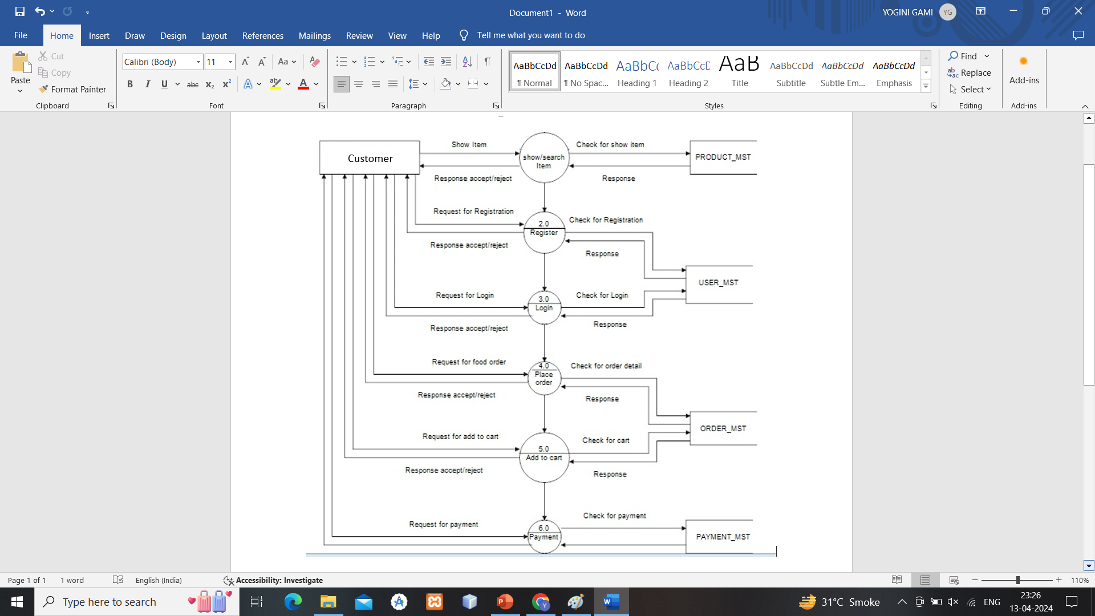
1st LEVEL
Customer
Side

Slide 17
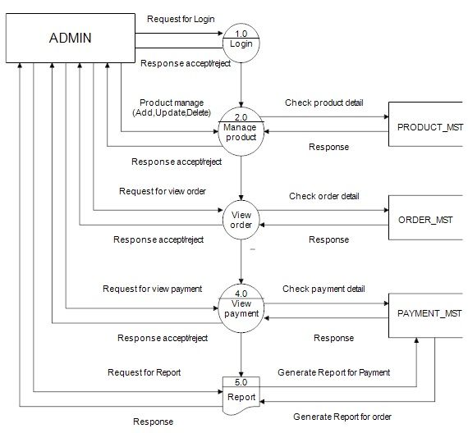
1st LEVEL
Admin
Side

Slide 18
Activity
Diagram

Slide 19
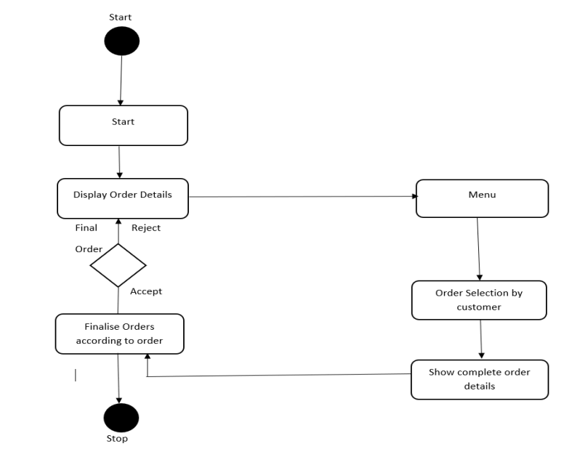

Slide 20
Use-case
(Diagram)

Slide 21
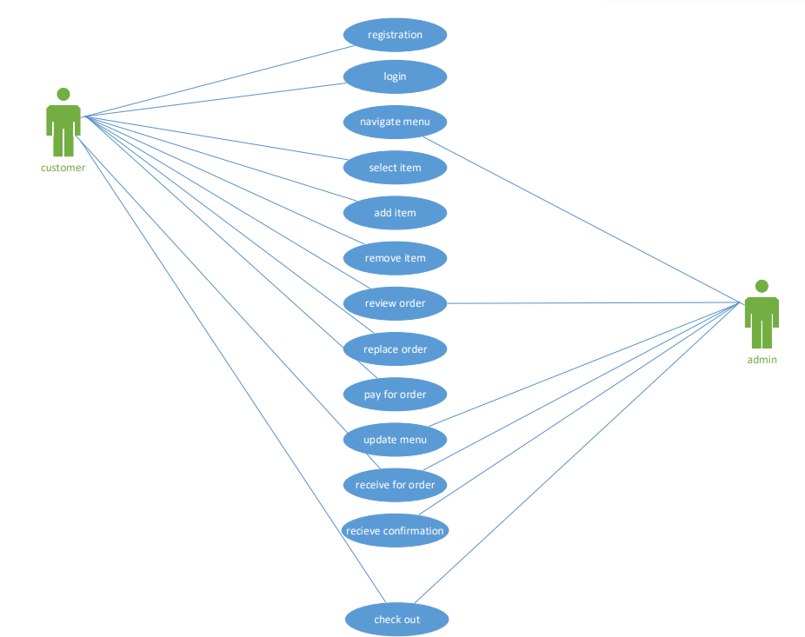

Slide 22
Data Dictionary

Slide 23
USER_MST
PRODUCT_MST
ORDER_MST
PAYMENT_MST

Slide 24
THANK YOU

